Slide 1
Big Mountain Resort: A case Study

Slide 2
The Problem
Current ticket price - $81
Would guests be willing to pay a higher premium given the amount and quality of facilities offered?
Can we increase profits for Big Mountain Resorts by 15% over the course of the next season by increasing ticket prices to be more in line with the resort offerings relative to other resorts in the market share?

Slide 3
Recommendation
Our model predicts that the market can support raising Big Mountain’s ticket price to from $81.00 to $95.87.
The cost of the new chair lift which was recently installed, is covered by an increase in ticket price of $0.88
Adding another run with increased vertical drop and adding another chair lift to support it allows for an increase in ticket price by $1.99
The model tells us that there are 4 standout features for predicting ticket prices. See next slides…

Slide 4
Modeling Results
Linear Regression:
R² = 0.68 and MAE = $11.80
Random Forest Regressor - 69 estimators:
R² = 0.71 , MAE = $9.60
Winning RF model suggests raising ticket price by just under $15

Slide 5
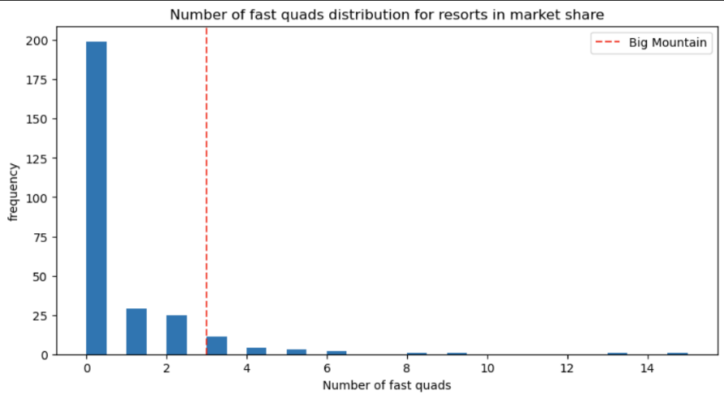
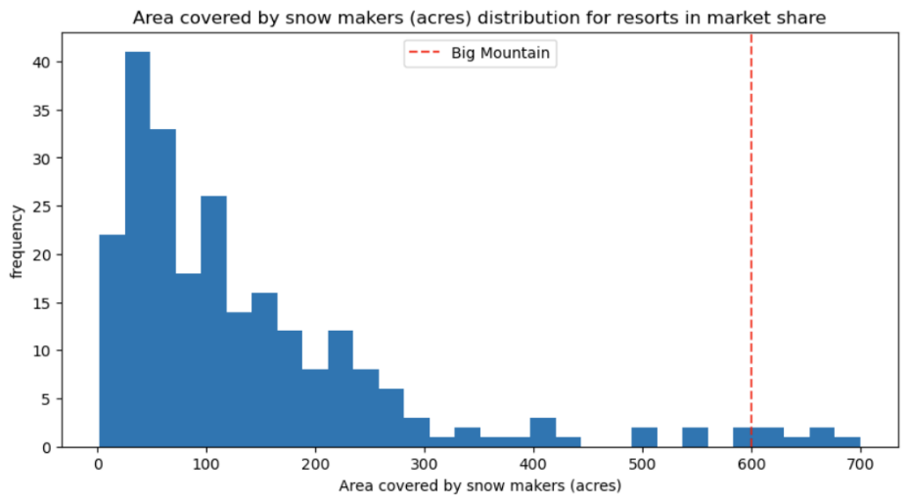
Modeling Results

Slide 6
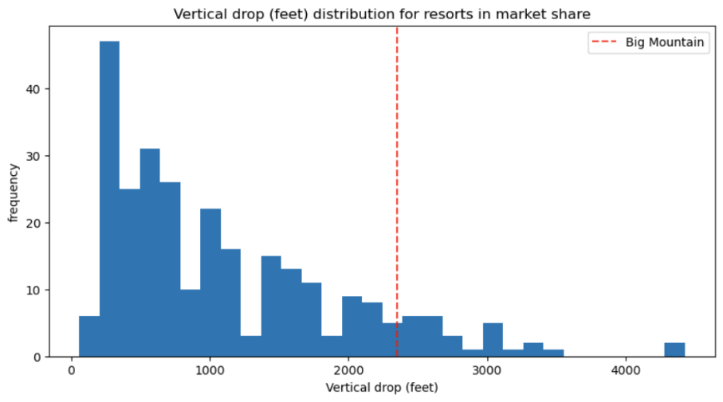
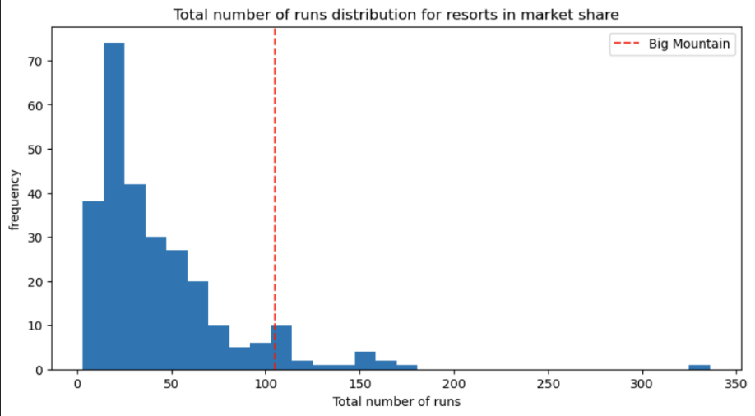
Modeling Results

Slide 7
Summary and Conclusion
When compared to other resorts in the country, Big Mountain's facilities lie in the upper end of what is offered across the country
The model suggests a higher ticket price is supported. ($81 → $96)
More data on maintenance costs and previous sales is required to make decisions on adding new features to the resort

